Slide 1
IBULE PHOTONICS
SINGLE CRYSTAL APPLICATIONS
A world leader in the development of high performance piezoelectric single crystals and applications.
www.ibule.com
Tel : 82-32-851-2908/2953
Fax : 82-32-851-2907
E-mail : sanggoo7@ibule.com
soisoi77@ibule.com
22, Gaetbeol-ro 145Beon-gil,
Yeonsu-gu, Incheon(21999), Republic of Korea

Slide 2
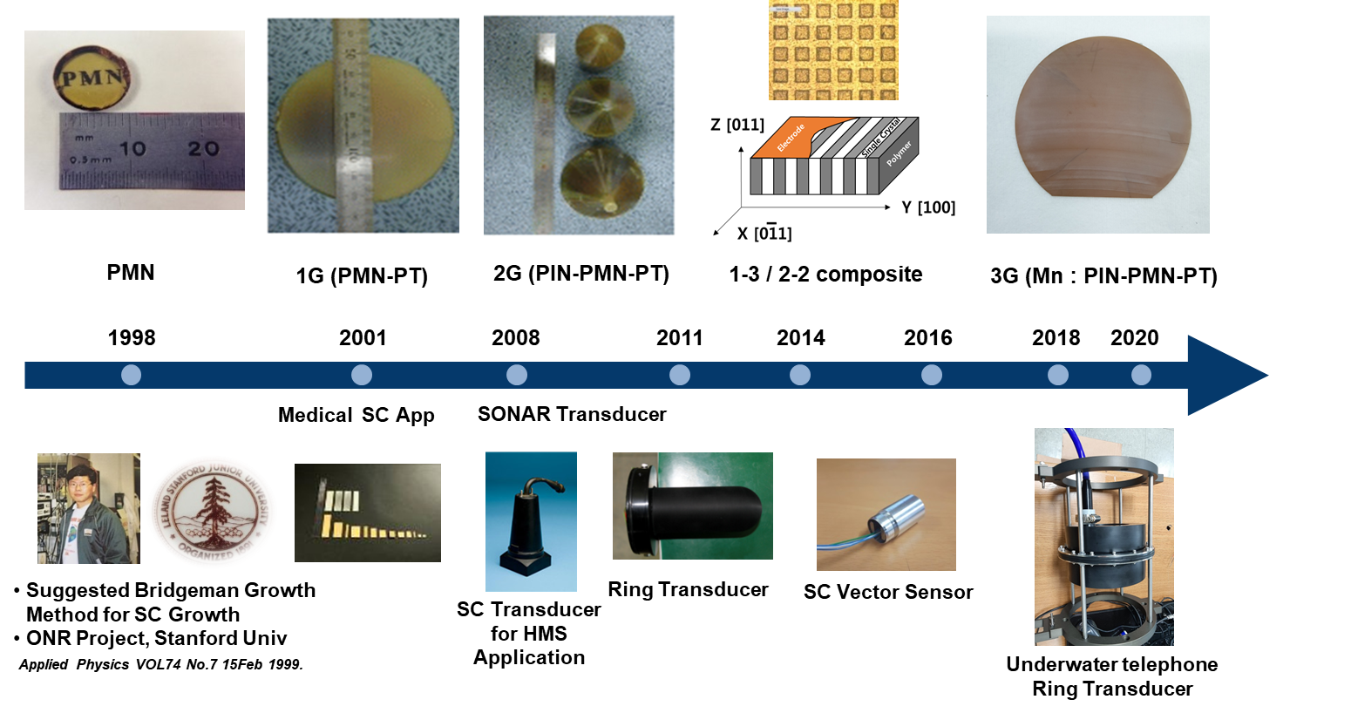
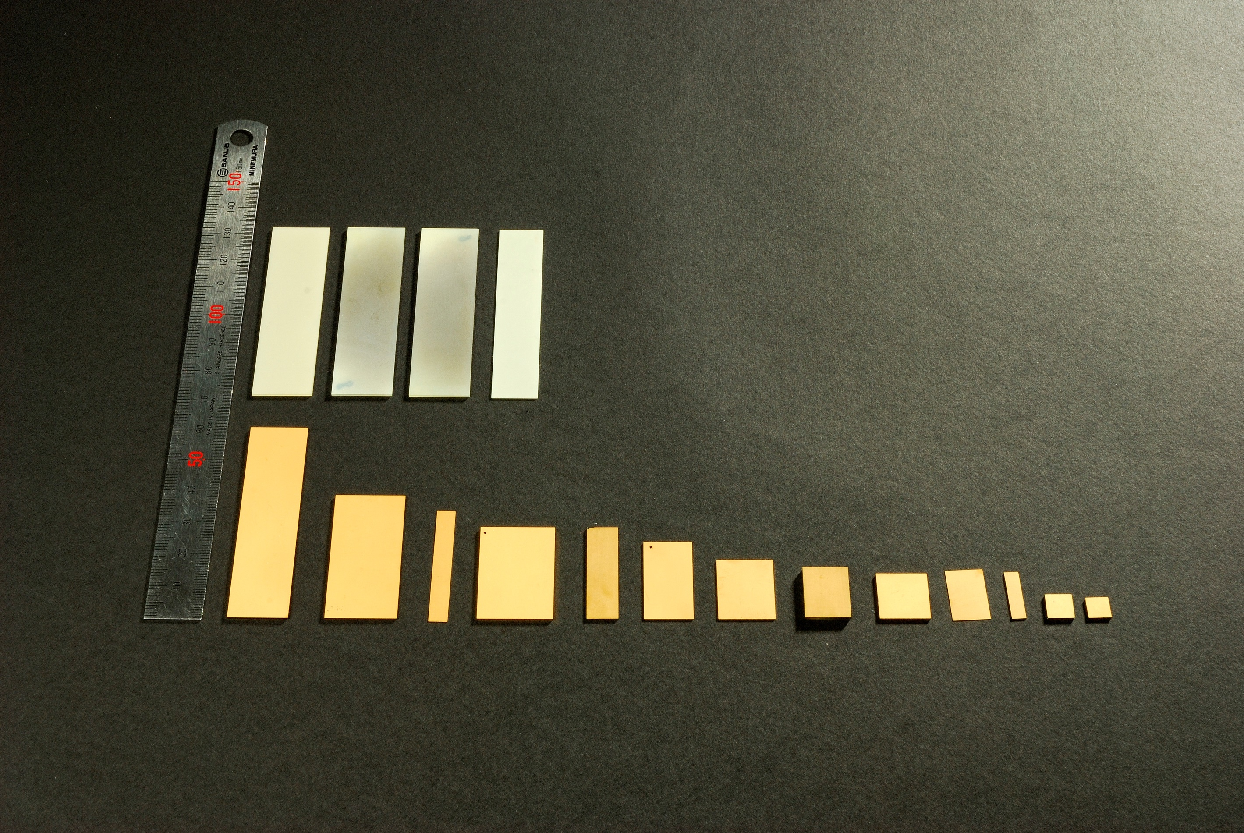
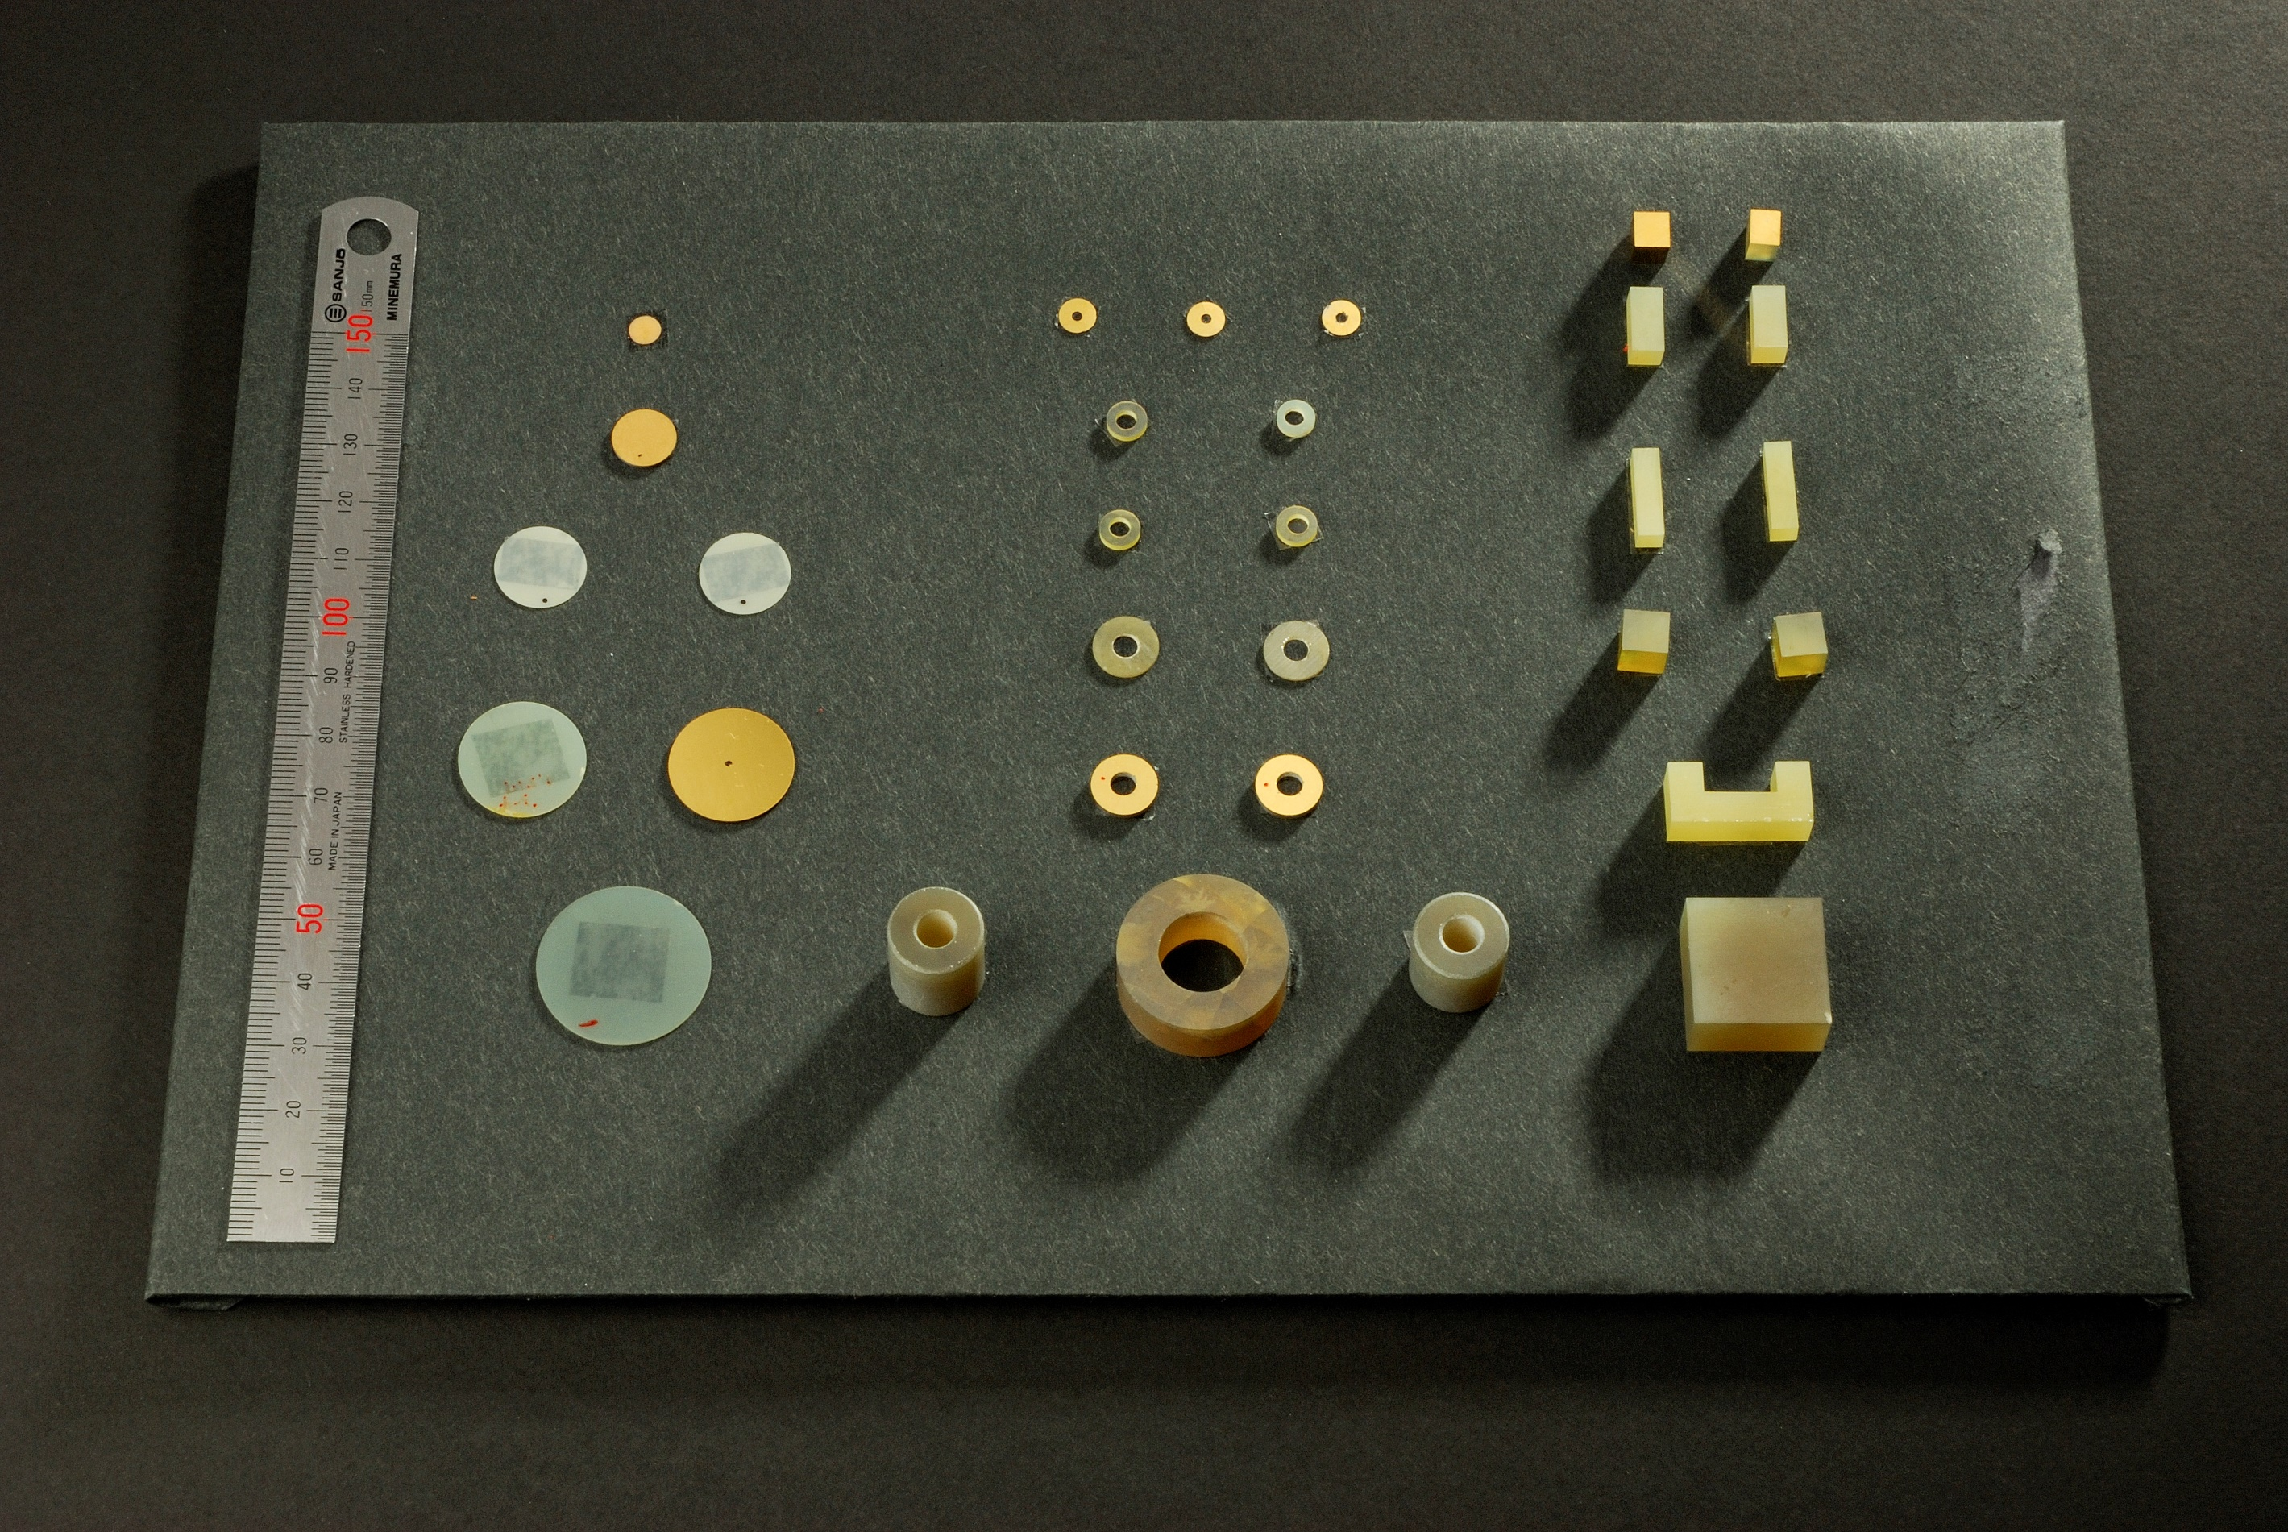
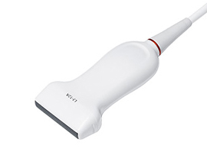
Company and Products
Founded in 1999, iBULe Photonics had successfully developed the single crystal growing technology based on the Bridgman method. Current products include 1G(PMN-PT), 2G(PIN-PMN-PT) single crystals in sizes up to 4.5” in diameter. They are produced in the direction of growth [001], [011] and [111].
iBULe is now a world leader in the development and manufacture of high-performance single crystals, and is rapidly expanding production capacities in order to provide customers with new opportunities for the next generation of transducers for defense and commercial applications.
Commercialization
iBULe, with over 20 years of experience in single crystal growth and characterization, has commercialized producing various sizes of [001],[011]-poled PMN-PT/Pin-PMN-PT wafers for medical ultrasound imaging transducers.

Slide 3
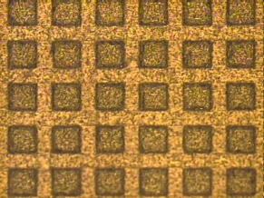
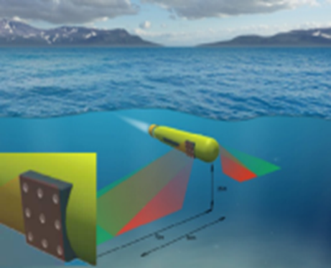
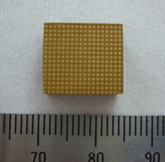
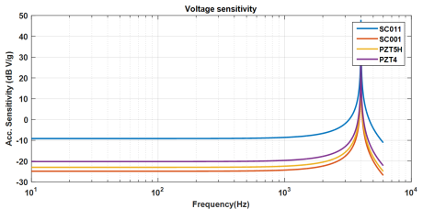
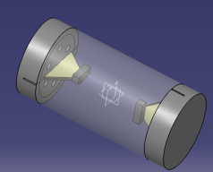
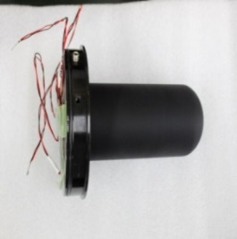
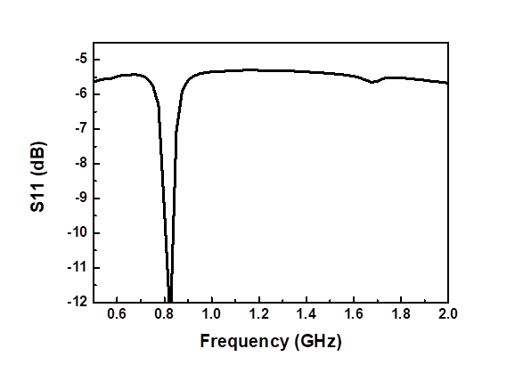
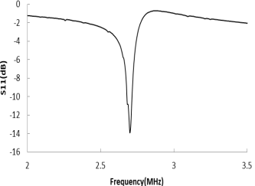
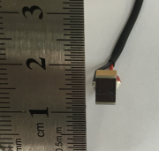
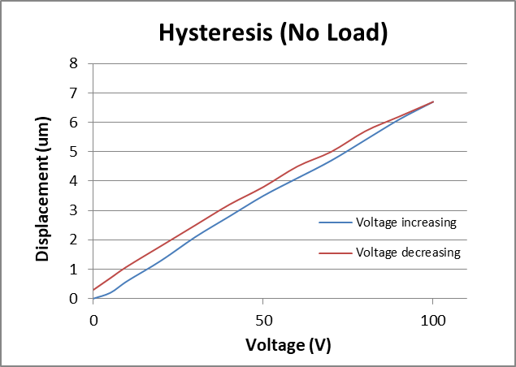
R&D Applications
iBULe has been actively involved in the various research projects in defense and industrial applications such as SONAR transducers, NDT(Non-destructive Testing) probes, actuator, IR sensor, energy harvesting devices, accelerometer, and so on.
Advantages of single crystals to PZT ceramics for applications
Increase in bandwidth and range (50% higher coupling constants over PZT)
Less electric input power (650% higher piezoconstants over PZT)
Reduction in overall transducer size (78% lower elastic modulus over PZT)
Strong anisotropy (piezo properties optimization by domain engineering)
“ NUWC, Office of Naval Research(ONR) Lynn M. Ewart, et, al
The International Symposium on Piezocrystals and their Applications July 22, 2015”
Single Crystal Composite
Broadband Tonpilz Transducer
A single crystal 2-2, 1-3 composite element which is small, lightweight and conformal to hull shape for hydrophone and communication receiver on UUV or AUV or on a submarine.
A transducer using 2-2, 1-3 composite single crystal for the potential applications to a SAS projector with a wider bandwidth and be capable of working at lower frequency than the existing one.
Vector Sensor / Accelerometer
Broadband Ring Transducer
A Cylindrical hydrophone and two orthogonally mounted cantilever beam accelerometers inside the cylinder.
Compact size and Light weight vector sensor compatible with the TAS in use
A compact broadband ring transducer for the potential applications to underwater acoustic communications, countermeasure and ASW on UUV or AUV or on a submarine.
FPSC MEMS resonator
Multilayer Actuator
0.8~1.5GHz resonance using [001] single crystal
Wine-Glass mode resonators using [011] single crystal
Wideband resonator
Over 50 stacking of single crystal which is small size and large displacements for actuator such as ‘Deformable Mirror’. (6.7um@100V)

Slide 4
Single Crystal Properties
1G: PMN-PT
Parameter | Units | [001] poled |  | [011] poled
 |  | Low-PT | High-PT | Low-PT | High-PT
$${ε_{33}}^{T}/ε_{0}$$ | $$−$$ | 4842 | 7000 | 3760 | 5770
$$d_{ij}$$ | $$×{10}^{−12}C/N$$ | $d_{33}$=1282 | $d_{33}$=1620 | $$d_{32}=−1140$$ | $$d_{32}=−1820$$
$${s_{ij}}^{E}$$ | $$×{10}^{−12}m^{2}/N$$ | ${s_{33}}^{E}$=47 | ${s_{33}}^{E}$=56 | ${s_{22}}^{E}$=53 | ${s_{22}}^{E}$=78
$$Trt$$ | $$℃$$ | 95 | 85 | 95 | 85
$$Ec$$ | $$KV/cm$$ | 2 | 2.5 | 2 | 2.5
$Density$ | $$kg/m^{3}$$ | 8080
2G: PIN-PMN-PT
Parameter | Units | [001] Poled |  | [011] Poled
 |  | Low-PT | High-PT | Low-PT | High-PT
$${ε_{33}}^{T}/ε_{0}$$ | $$−$$ | 4457 | 5666 | 3449 | 4656
$$d_{ij}$$ | $$×{10}^{−12}C/N$$ | $d_{33}$=1226 | $d_{33}$=1840 | $$d_{32}=−1323$$ | $$d_{32}=−1870$$
$${s_{ij}}^{E}$$ | $$×{10}^{−12}m^{2}/N$$ | ${s_{33}}^{E}$=49 | ${s_{33}}^{E}$=79 | ${s_{22}}^{E}$=72 | ${s_{22}}^{E}$=99
$$Trt$$ | $$℃$$ | 120 | 90 | 120 | 90
$$Ec$$ | $$KV/cm$$ | 4 | 6 | 4 | 6
$Density$ | $$kg/m^{3}$$ | 8154
Unique piezo single crystal properties create opportunities for unprecedented system performance.

